Slide 1
Topic 19 Vapor-Compression Cycles
Thermodynamics: An Engineering Approach
8th Edition Yunus A. Çengel, Michael A. Boles
McGraw-Hill, 2015

Slide 2
Objectives
Introduce the concepts of refrigerators and heat pumps and the measure of their performance.
Analyze the ideal vapor-compression refrigeration cycle.
Analyze the actual vapor-compression refrigeration cycle.

Slide 3
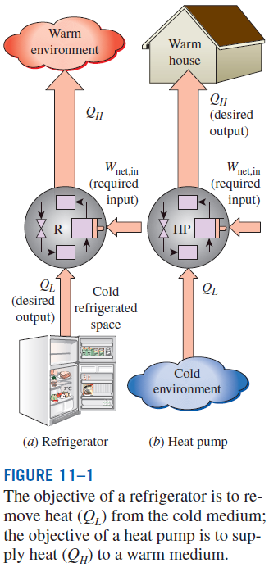
REFRIGERATORS AND HEAT PUMPS
The transfer of heat from a low-temperature region to a high-temperature one requires special devices called refrigerators.
Another device that transfers heat from a low-temperature medium to a high-temperature one is the heat pump.
Refrigerators and heat pumps are essentially the same devices; they differ in their objectives only.
for fixed values of Q_{L} and Q_{H}

Slide 4
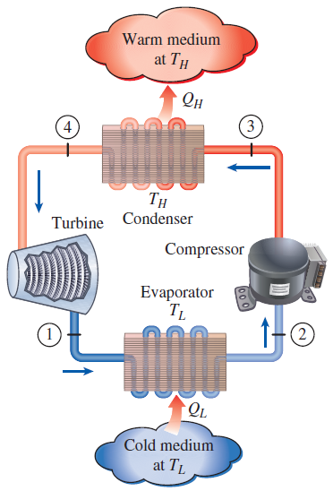

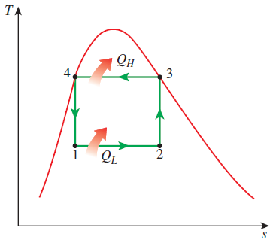
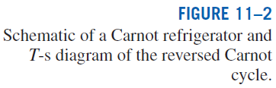
THE REVERSED CARNOT CYCLE
The reversed Carnot cycle is the most efficient refrig. cycle operating between T_{L} and T_{H}.
It is not a suitable model for refrigeration cycles since processes 2-3 and 4-1 are not practical because Process 2-3 involves the compression of a liquid–vapor mixture, which requires a compressor that will handle two phases, and process 4-1 involves the expansion of high-moisture-content refrigerant in a turbine.
Both COPs increase as the difference between the two temperatures decreases, that is, as T_{L} rises or T_{H} falls.

Slide 5
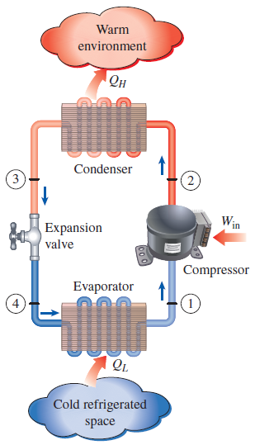
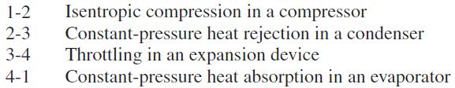
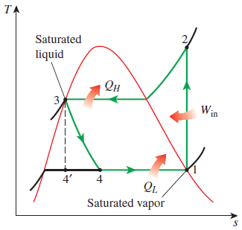
THE IDEAL VAPOR-COMPRESSION REFRIGERATION CYCLE
The vapor-compression refrigeration cycle is the ideal model for refrigeration systems. Unlike the reversed Carnot cycle, the refrigerant is vaporized completely before it is compressed and the turbine is replaced with a throttling device.
This is the most widely used cycle for refrigerators, A-C systems, and heat pumps.
Schematic and T-s diagram for the ideal vapor-compression refrigeration cycle.

Slide 6
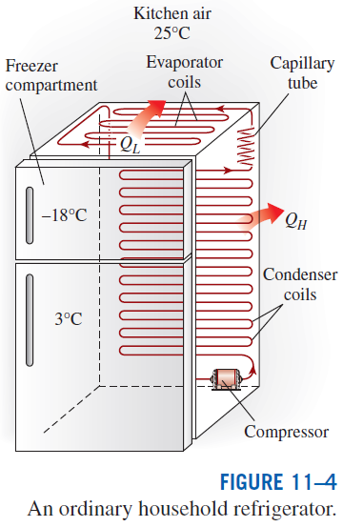
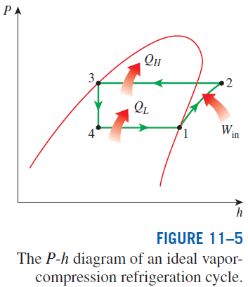
The ideal vapor-compression refrigeration cycle involves an irreversible (throttling) process to make it a more realistic model for the actual systems.
Replacing the expansion valve by a turbine is not practical since the added benefits cannot justify the added cost and complexity.
Steady-flow energy balance

Slide 7
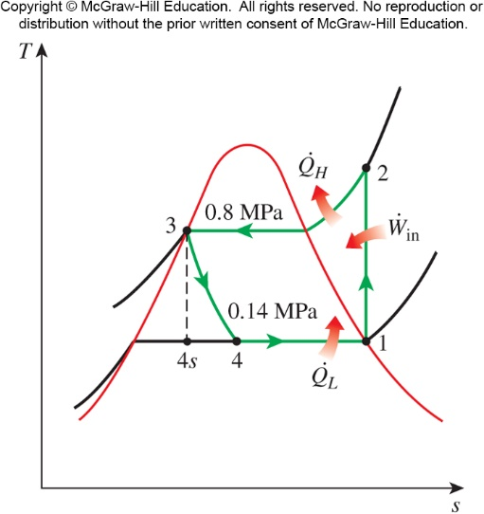
The Ideal Vapor-Compression Refrigeration Cycle
A refrigerator uses R-134a as the working fluid and operates on an ideal vapor-compression refrigeration cycle between 0.14 and 0.8 MPa. If the mass flow rate of the refrigerant is 0.05 kg/s, determine the rate of heat removal from the refrigerated space and the power input to the compressor, the rate of heat rejection to the environment, and the COP of the refrigerator.
Example 1

Slide 8
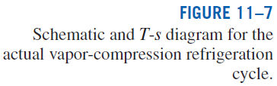
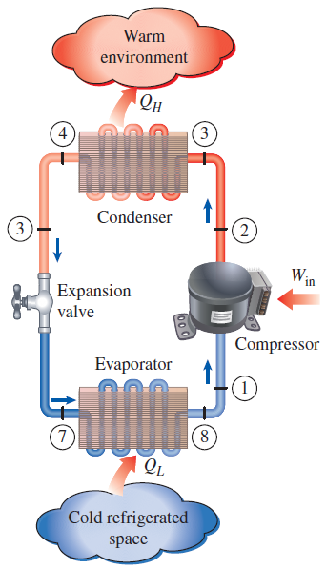
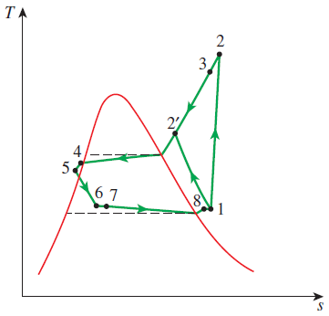
ACTUAL VAPOR-COMPRESSION REFRIGERATION CYCLE
An actual vapor-compression refrigeration cycle differs from the ideal one owing mostly to the irreversibilities that occur in various components, mainly due to fluid friction (causes pressure drops) and heat transfer to or from the surroundings.
DIFFERENCES
Non-isentropic compression
Superheated vapor at evaporator exit
Subcooled liquid at condenser exit
Pressure drops in condenser and evaporator
The COP decreases as a result of irreversibilities.

Slide 9
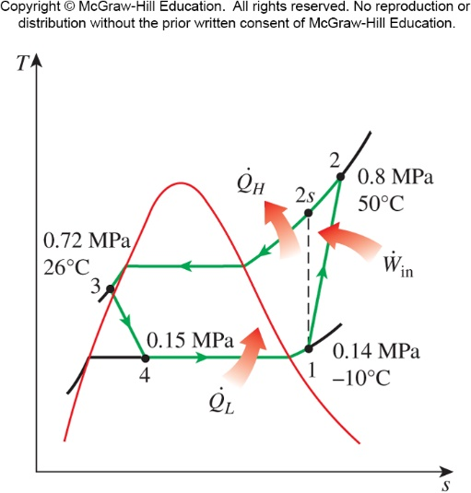
Actual Vapor-Compression Refrigeration Cycle
R-134a enters the compressor of a refrigerator as a superheated vapor at 0.14 MPa and -10ºC at a rate of 0.05 kg/s and leaves at 0.8 MPa and 50ºC. The refrigerant is cooled in the condenser to 26ºC and 0.72 MPa and is throttled to 0.15 MPa. Disregarding any heat transfer and pressure drops in the connecting lines between components, determine the rate of heat removal from the refrigerated space and the power input to the compressor, the isentropic efficiency of the compressor, and the COP of the refrigerator.
Example 2

Slide 10
Summary
Refrigerators and Heat Pumps
The Reversed Carnot Cycle
The Ideal Vapor-Compression Refrigeration Cycle
Actual Vapor-Compression Refrigeration Cycle

